Slide 1

University of Toronto Data Visualization Boot Camp – Project 2 Football App
Mauricio Avila, Gurpreet Chugh,
Jeremy Mallory, Doran Rainford
Gavin Toole, Anthony Verma

Slide 2






Create an app showing team, player, and stadium data
The app contains and filters by league:
Leaflet map with stadiums showing name, capacity, and trivia about the stadium
Add from the original data set
Sunburst chart showing the goals scored broken down by league, team, players
Player goals was added from the original dataset as during our presentation a question was asked regarding players
Combination bar and line graph outlining team total points and wages.

Slide 3
Analysis Process – Player Data
Original data was retrieved from: https://fbref.com/en
Site was used to extract the player data as well, previous we used the pd.read_html but the player data was not in the same format, Beautiful soup was used to web scrap the player data.

Slide 4
Analysis Process – Stadium Data
Stadium data was retrieved from: https://stadiumguide.com
This site didn’t have the latitude and longitude, code created to get coordinates from geoapify
Challenge in retrieving trivia for the stadium was that in stadium table, on clicking stadium name, the url of the page containing description about the stadium did not have the stadium name consistent with the stadium name on home page. E.g. The stadium name on the home page www.stadiumguide.com is Estadio ABANCA-Riazor but the stadium description url for the stadium https://www.stadiumguide.com/riazor/ contains riazor. We accessed the href links in all the tags on home page and then using those href urls we accessed the stadium page to get the trivia

Slide 5

Leaflet
A custom map marker was added by downloading icon and adding to html script
Pop up on marker included:
Stadium Name
Capacity
Trivia about the stadium
For the custom marker an image was added to the html and called with the following code
var soccerIcon = L.icon({ iconUrl: 'static/football_marker.png', iconSize: [50, 50],});
L.marker((stadCoords),{icon: soccerIcon}).bindPopup

Slide 6
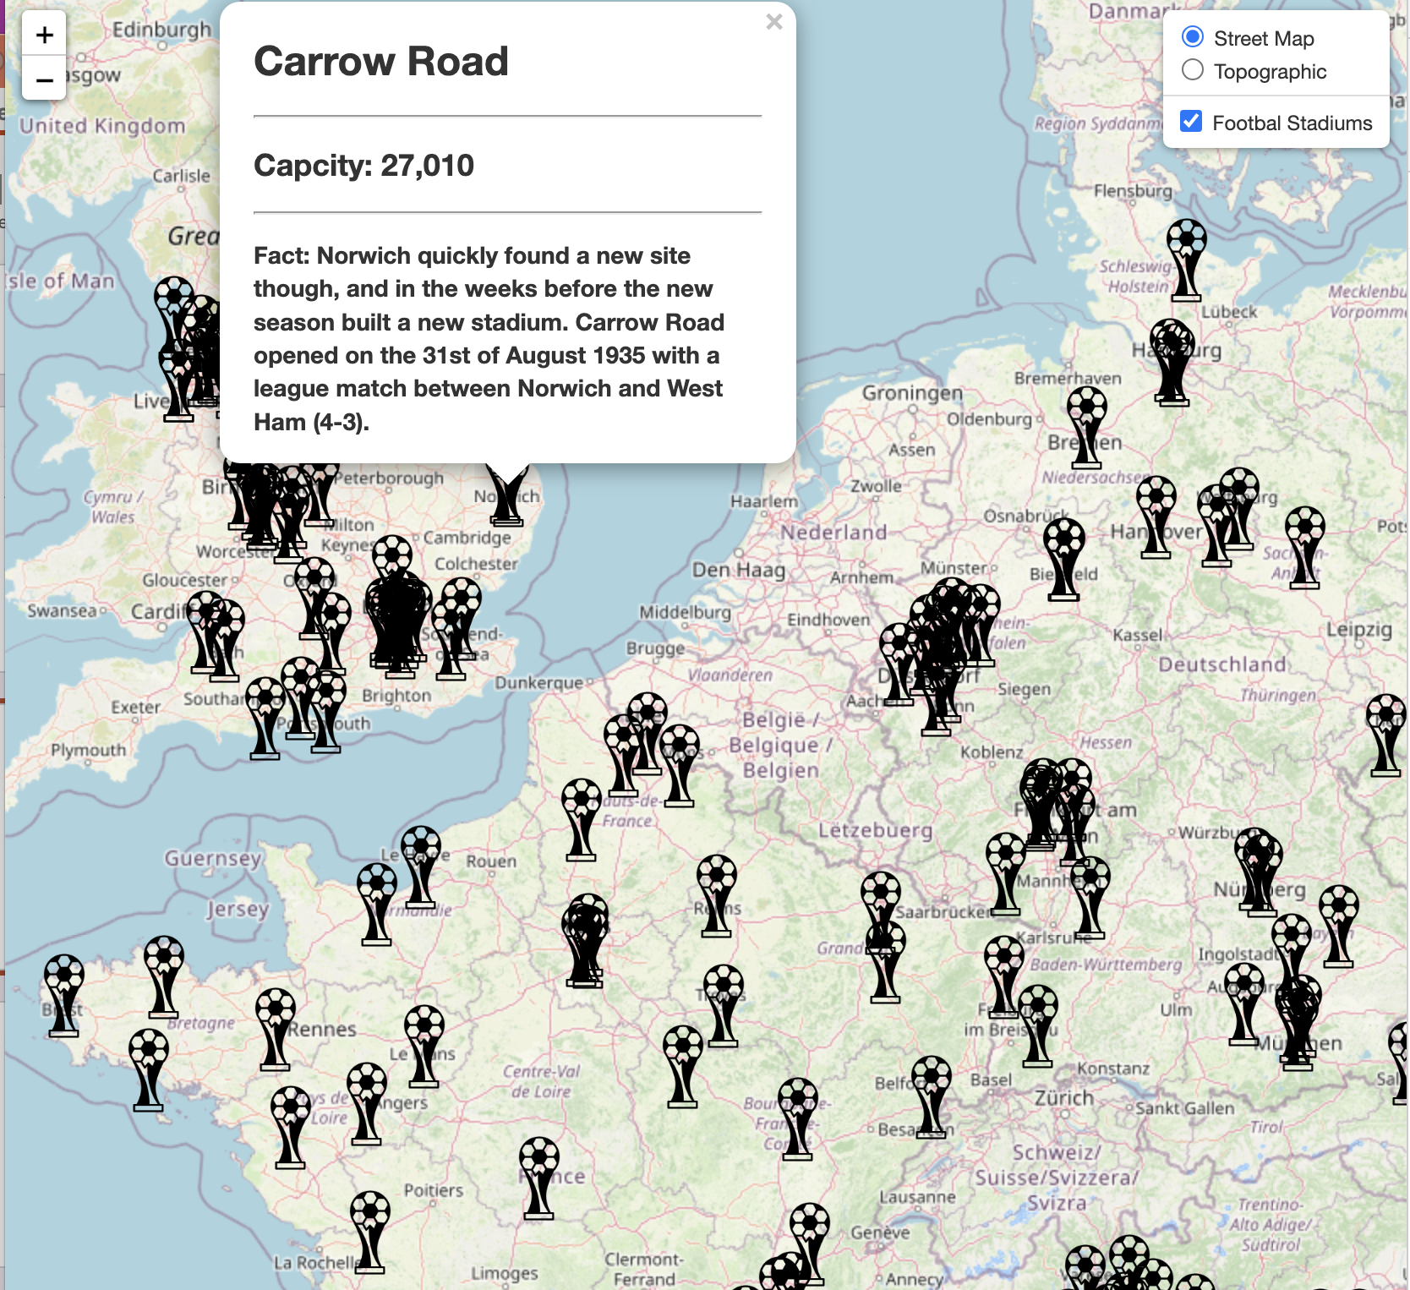
Leaflet

Slide 7
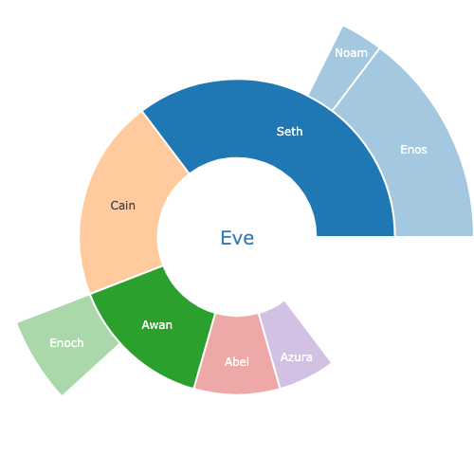
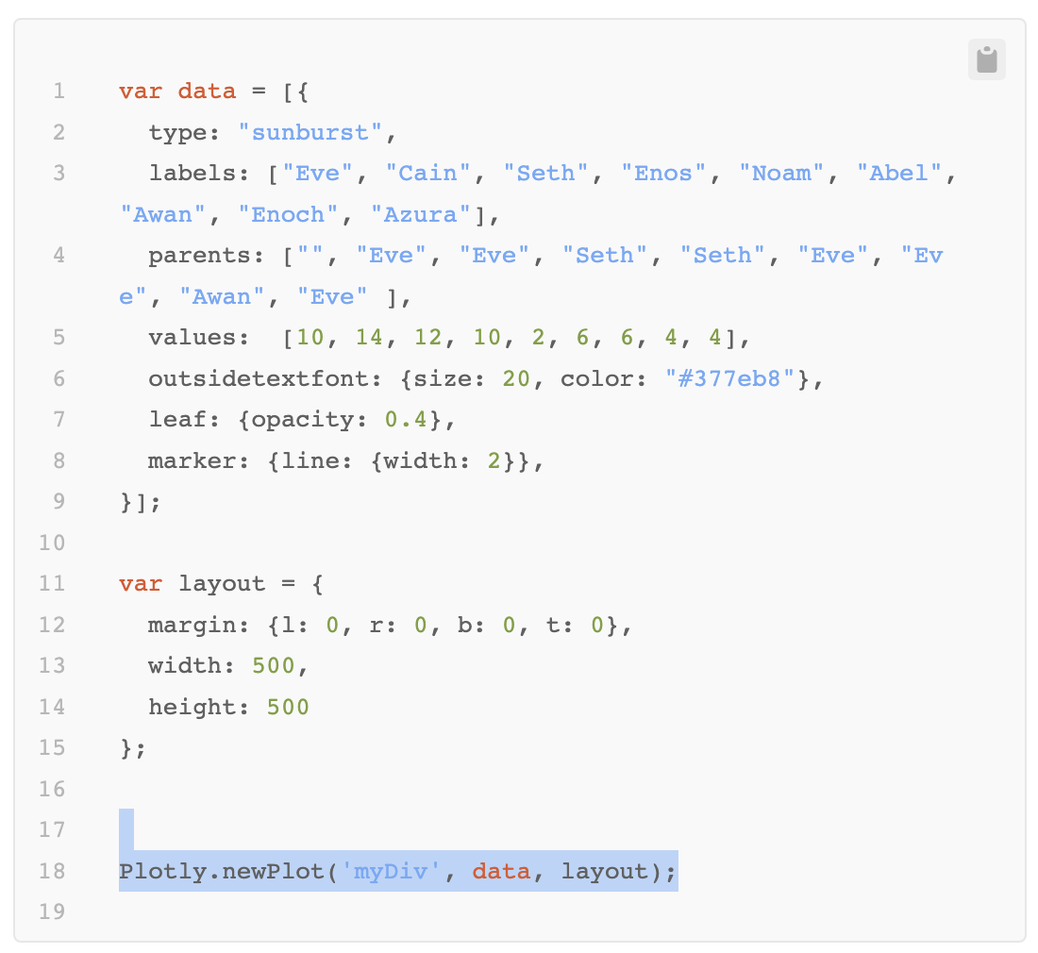
Plotly - Sunburst
values = []
labels = []
parents = []
for league in leagues:
values.push(league.goals)
Labels.push(League.name)
parents.push("")
For team in league:
values.push(team.goals)
labels.push(team.name)
parents.push(league.name)
for player in team:
values.push(player.goals)
labels.push(player.name)
parents.push(team.name)

Slide 8
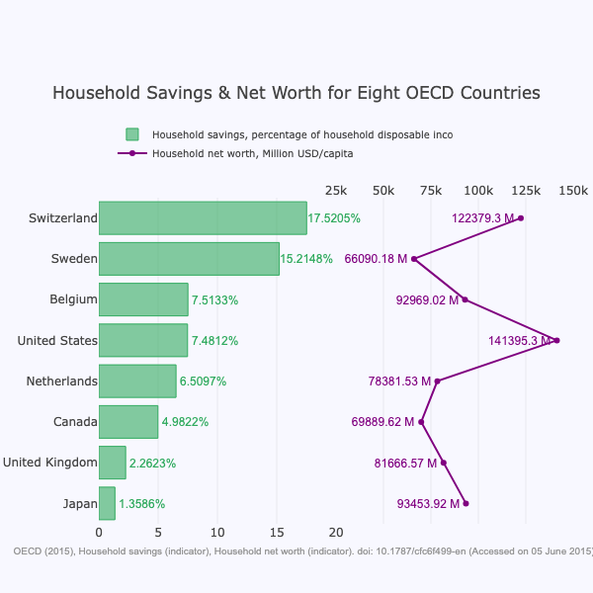
Plotly – Bar char with Line Pliot
Displays Team points on the bars with wages on the line plot

